Slide 1
Human Trafficking and migration
Team Neurath:
Evelyne Benie, Mike McPartlin,
Xander Roy, Matt Tabaka

Slide 2
Agenda
Research Questions
Data Analysis
Conclusion
Learnings
Resources

Slide 3
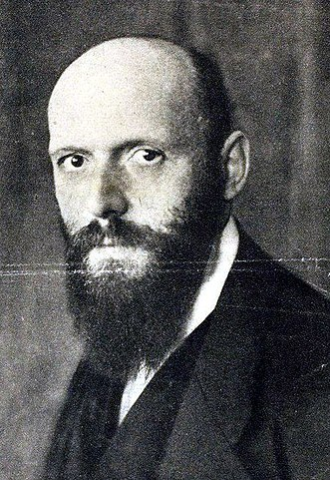
Otto Neurath: collaborated with the German artist Gerd Arntz to create the Vienna method of pictorial statistics also known as the …

Slide 4
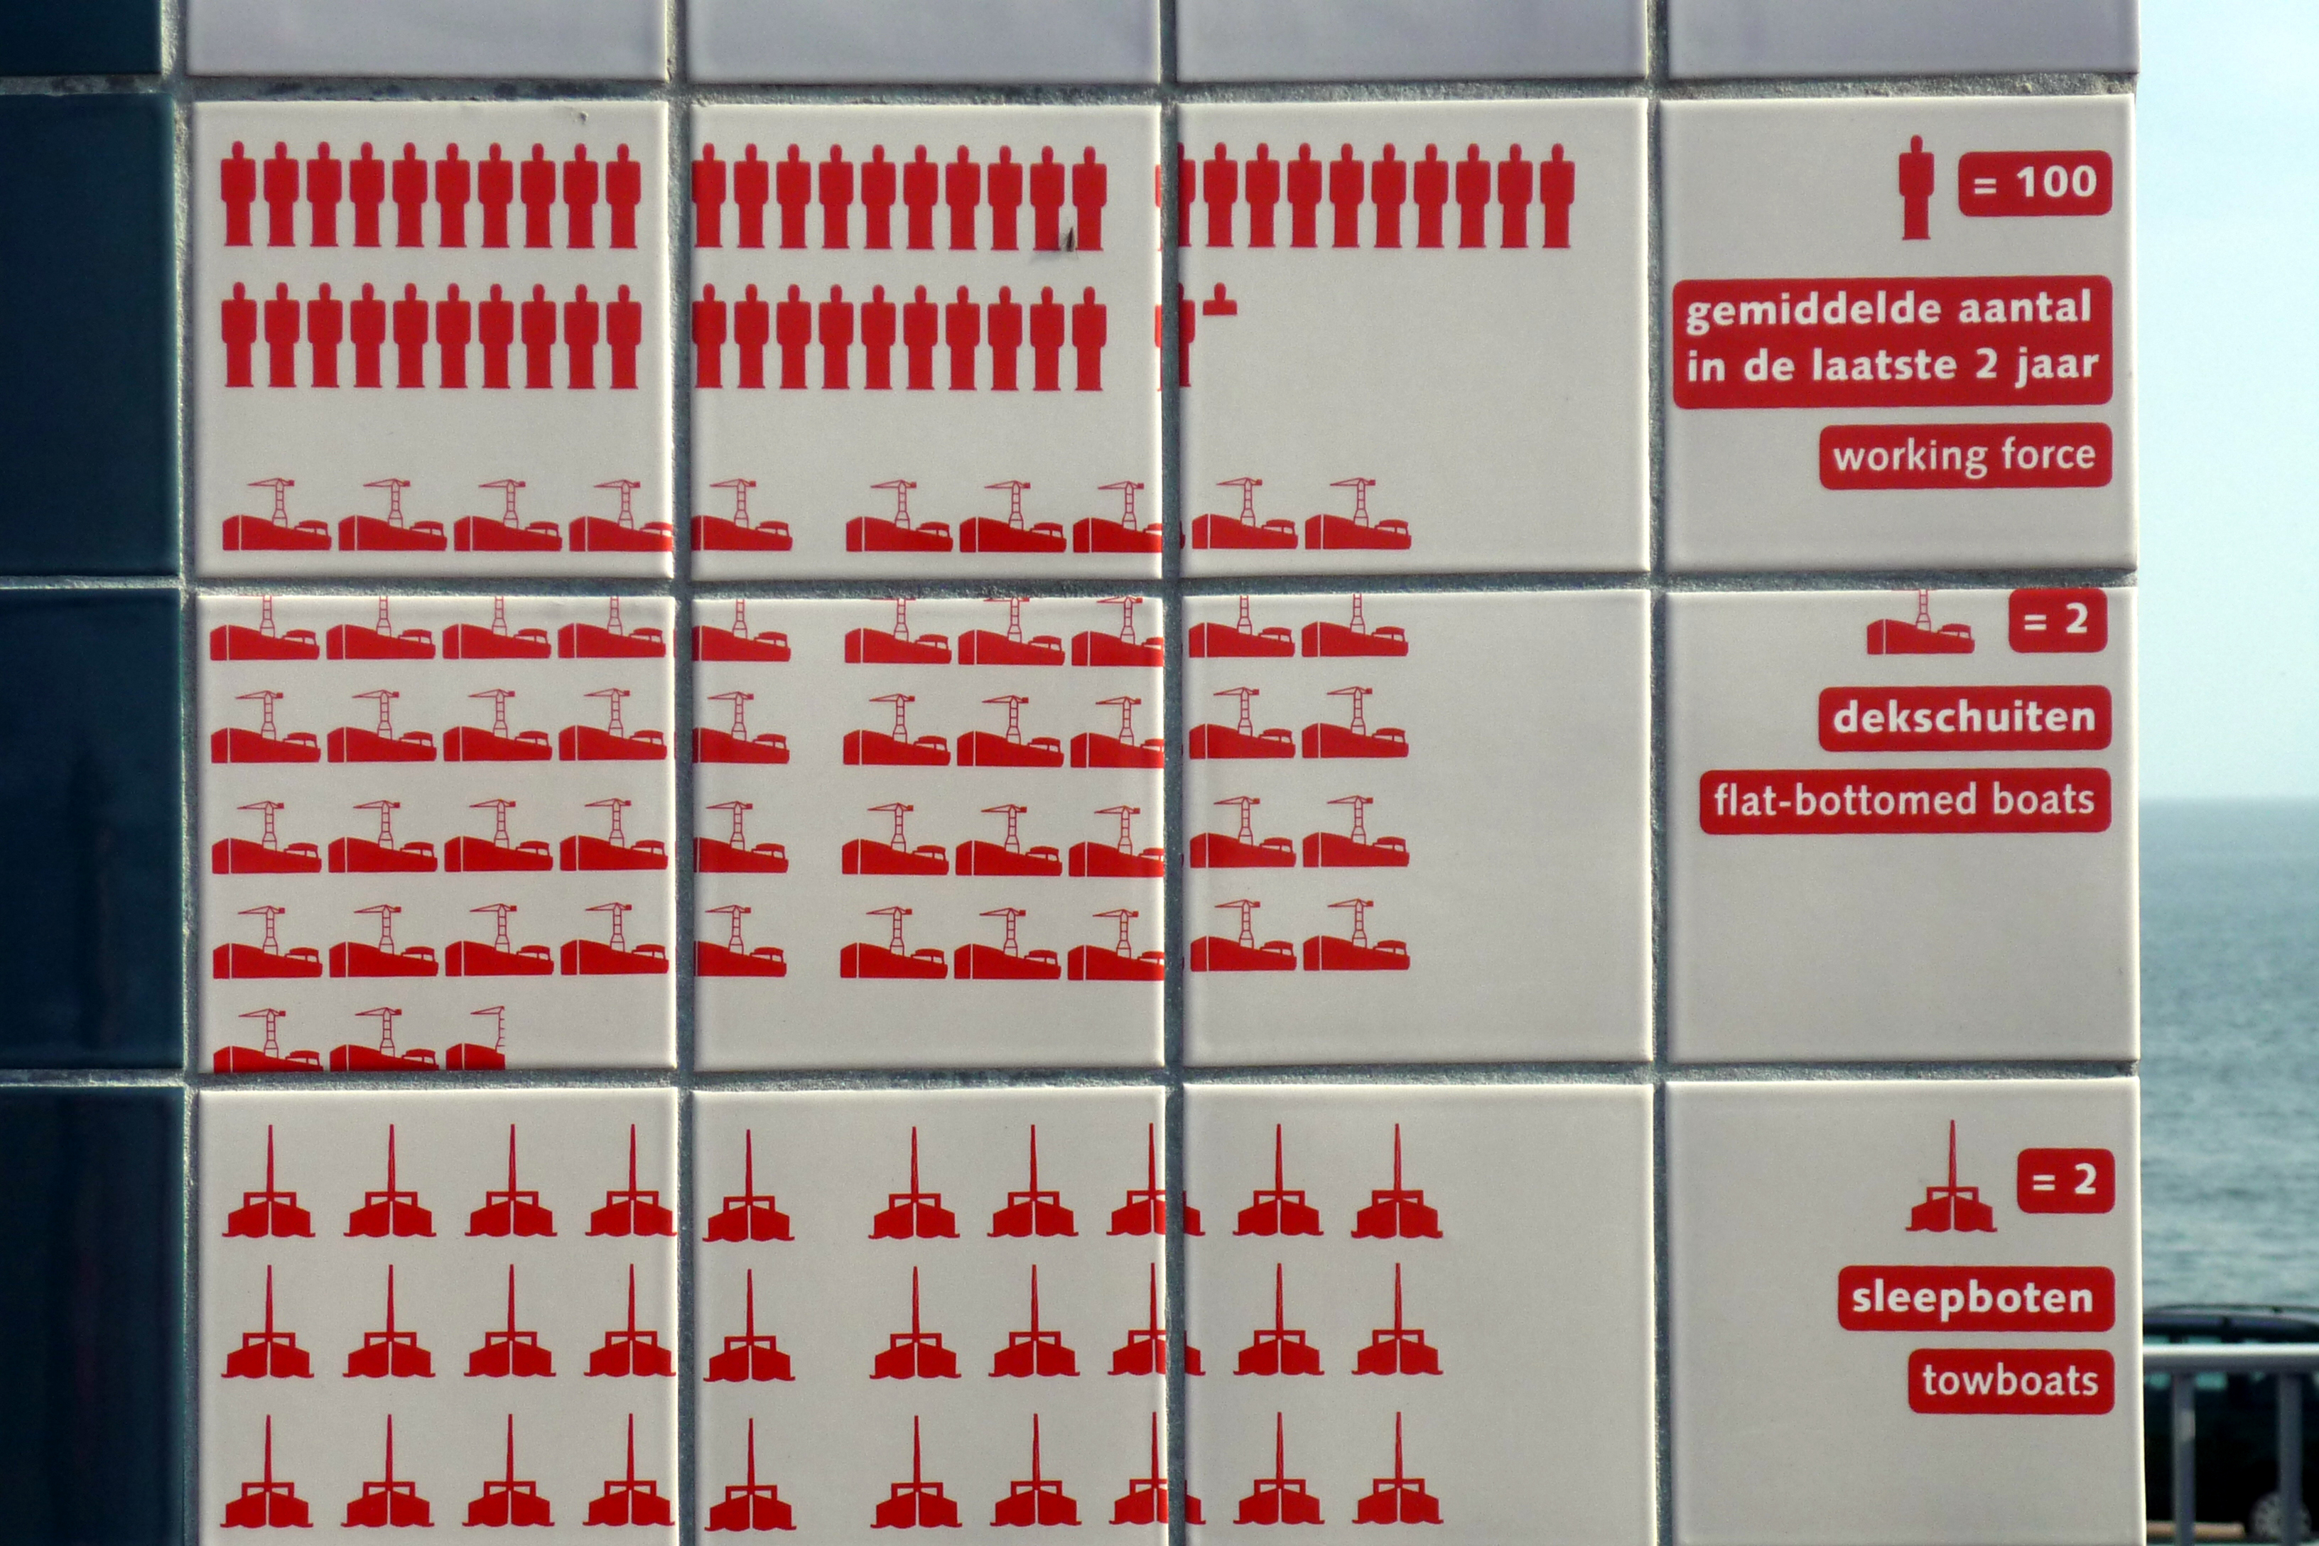
Isotype!

Slide 5
Research Questions
We want to study the economic conditions in which human trafficking occurs worldwide, including wealth, social and gender inequalities, migration due to political instability, war and poverty; and the role of migration in the proliferation of this crime in recent years.
We want to know if there is a correlation between legal migration and human trafficking worldwide. Using interactive data visualizations we want to determine if the proliferation of human trafficking is different among gender groups and age groups.

Slide 6
Data sources
https://www.ctdatacollaborative.org/
http://www.un.org/en/development/desa/population/migration/data/estimates2/estimates17.shtml

Slide 7
Migration Data
Visualize Human Trafficking Data on a global scale
Worldwide Migration
Age (Youth or Elder)
Sex
Country of Origin
Country Destination

Slide 8
Trafficking Data
Human Trafficking numbers reported
Data used contained:
Citizenship of victim
Year
Gender
Country of Exploitation
Age was defined as Adult, Youth or Unknown

Slide 9
Economic indicators
GDP
YEAR

Slide 10
Challenges
Data sources on Trafficking are not uniform:
“One of the key gaps in our ability to respond effectively to the global trafficking crisis has to do with the lack of coordinated and reliable data” David Cohen, director of Stanford’s WSD Handa Center for Human Rights and International Justice.
https://news.stanford.edu/2018/09/05/get-good-data-human-trafficking/

Slide 11
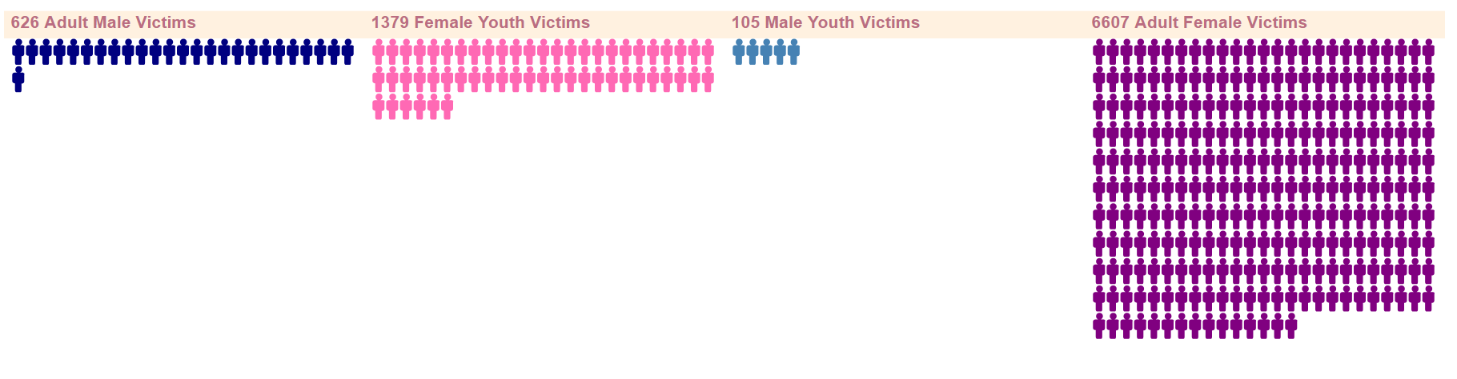
ISOTYPE GRAPH

Slide 12
GRAPHS

Slide 13
GLOBE

